Slide 1
Grade-7
Lesson-1
THE MEDIEVAL WORLD

Slide 2
Case: You are an Archaeologist excavating a region X. In the course of your excavation you find a broken pot, some coins and a few shells. Based on these findings what conclusion can you draw about the people who inhabited this region?
Lesson -1/NAME- THE MEDIEVAL WORLD/FACULTY- Mrs Sujatha/
DEPT-SOCIAL SCIENCE/SNS ACADEMY

Slide 3
DIVISION OF MEDIEVAL PERIOD
MEDIEVAL PERIOD
EARLY MEDIEVAL PERIOD LATE MEDIEVAL PERIOD
8TH CENTURY-13TH CENTURY 13TH CENTURY – 18TH CENTURY
Palas Turks
Cholas Afghans
Pratiharas Mughals…..
Rashtrakutas …
Lesson -1/NAME- THE MEDIEVAL WORLD/FACULTY- Mrs Sujatha/
DEPT-SOCIAL SCIENCE/SNS ACADEMY

Slide 4
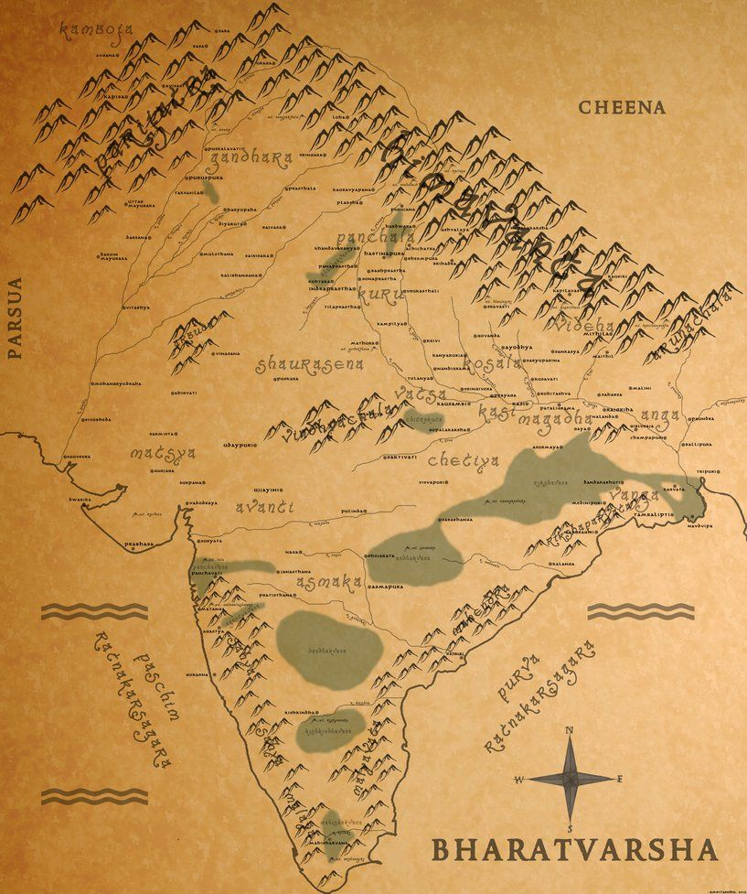
Names of India
Bharatvarsha
Jambudwipa
Sindhu – Hindu- Inde – India
Lesson -1/NAME- THE MEDIEVAL WORLD/FACULTY- Mrs Sujatha/
DEPT-SOCIAL SCIENCE/SNS ACADEMY
3

Slide 5
Major Historical development
The arrival of the Mughals
Increase in trade
Greater interaction between people of different parts of the world
Islam spread
Lesson -1/NAME- THE MEDIEVAL WORLD/FACULTY- Mrs Sujatha/
DEPT-SOCIAL SCIENCE/SNS ACADEMY
5/13

Slide 6
SOURCES
ARCHAEOLOGICAL SOURCES LITERARY SOURCES
Temples Chronicles of court historians
Palaces Biographies
Mosques Autobiography
Forts Farmans
Tombs Travelogues
Coins
Inscription
Utensils
Tools
Weapons
Ornaments
Paintings
Lesson -1/NAME- THE MEDIEVAL WORLD/FACULTY- Mrs Sujatha/
DEPT-SOCIAL SCIENCE/SNS ACADEMY
6/13

Slide 7
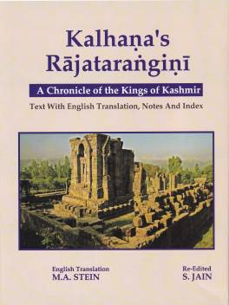
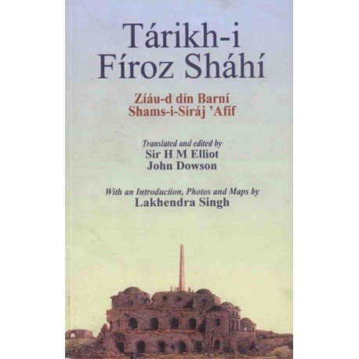
CHRONICLES
Lesson -1/NAME- THE MEDIEVAL WORLD/FACULTY- Mrs Sujatha/
DEPT-SOCIAL SCIENCE/SNS ACADEMY
7/13

Slide 8
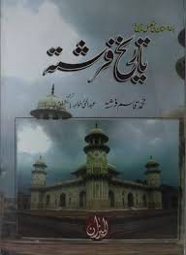
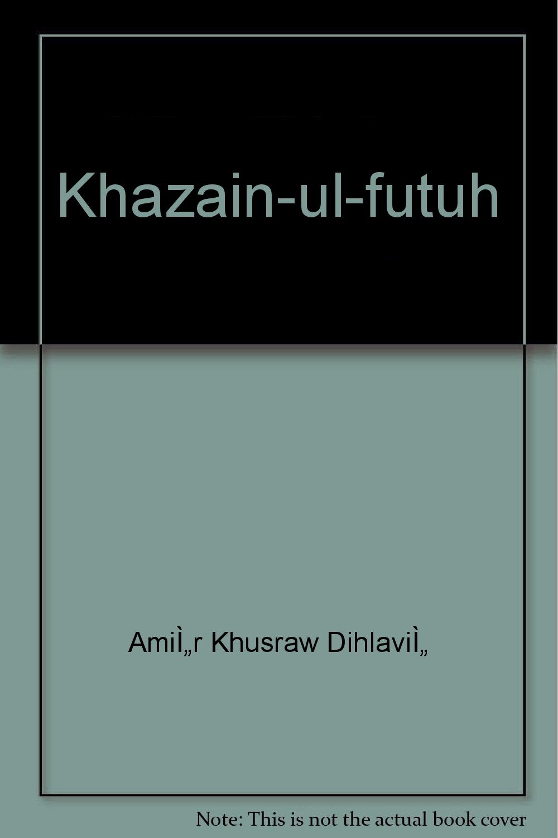
CHRONICLES
Lesson -1/NAME- THE MEDIEVAL WORLD/FACULTY- Mrs Sujatha/
DEPT-SOCIAL SCIENCE/SNS ACADEMY
8/13

Slide 9
CHRONICLES
AUTHOR | WORK
KALHANA | RAJATARANGINI
ZIA-UD-DIN-BHARANI | TARIKH-I-FIROZ
FERISHTA | TARIKH –I FERISHTA
AMIR KHUSRAU | TUGHLUQNAMA
AMIR KHUSRAU | KHAZAINUL-FUTUH
Lesson -1/NAME- THE MEDIEVAL WORLD/FACULTY- Mrs Sujatha/
DEPT-SOCIAL SCIENCE/SNS ACADEMY

Slide 10
AUTOBIOGRAPHIES
AUTOBIOGRAPHY | AUTHOR
FUTUHAT- I FIROZ SHAHI | FIROZ-SHAH-TUGHLUQ
BABURNAMA | BABUR
TUZUK- I JAHANGIRI | JAHANGIR
BIOGRAPHY | AUTHOR
PRITHVIRAJ-RASO | CHANDBARDAI
HUMAYUNNAMA | GULBADAN BEGUM
AKBARNAMA | ABDULFAZL
Lesson -1/NAME- THE MEDIEVAL WORLD/FACULTY- Mrs Sujatha/
DEPT-SOCIAL SCIENCE/SNS ACADEMY

Slide 11
TRAVELOGUES &TRAVELLERS
TRAVELLERS | PLACE FROM WHERE THEY ARRIVED
ALBERUNI | CENTRAL ASIA
IBN BATUTAH | MOROCCO
ABDUR RAZZAQ | PERSIA
MARCO POLO NICOLO CONTI | ITALY
DUARTE BARBOSA DOMINGO PAES | PORTUGAL
WILLIAM HAWKINS SIR THOMAS ROE | ENGLAND
BERNIER TAVERNIER | FRANCE
Lesson -1/NAME- THE MEDIEVAL WORLD/FACULTY- Mrs Sujatha/
DEPT-SOCIAL SCIENCE/SNS ACADEMY

Slide 12
TIME TO LEARN
QUESTIONS:
What do you understand by the Indian culture that emerged in the Medieval period?
How are travelogues an important literary source?
Our information about the Medieval period is much more than the ancient period. Explain.
12

Slide 13
Surfing activity:
rsgr.in/sh0061
rsgr.in/sh0062
13

